Slide 1

Introductory Computer Networking and IT Security
Week 7

Slide 2
Agenda
Introduction to Access Control List
Types of Access Control List
Wildcard masking
Authentication and managing traffic with Access Control List (configuration)

Slide 3
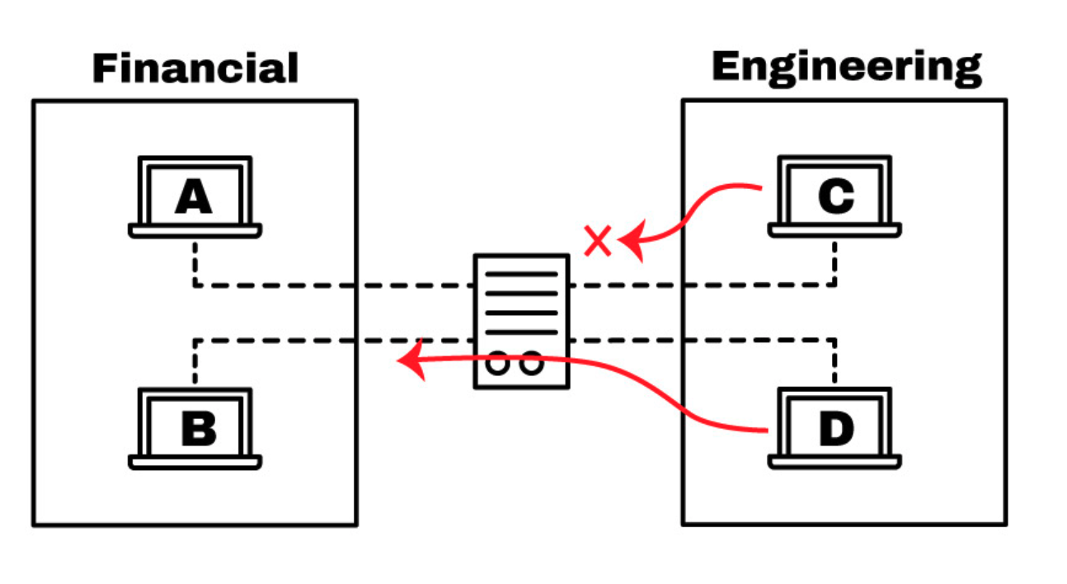
Access List
With ACL we can deny access to host C into the Financial network,
and at the same time, allowing access to host D.

Slide 4

Access Control List
A list of permissions or conditions are categorizes packets
Used to exercise control over network traffic.
Used to filter unwanted packets when implementing security policies.
Used to control which networks will or won’t be advertised by dynamic routing protocols

Slide 5
Access Control List
Used access lists to categorize packets for queuing or QoS-type services
Used for controlling which types of traffic can activate a pricey ISDN link.
ACLs are directly configured in a device’s forwarding hardware, so they do not compromise the end performance.

Slide 6
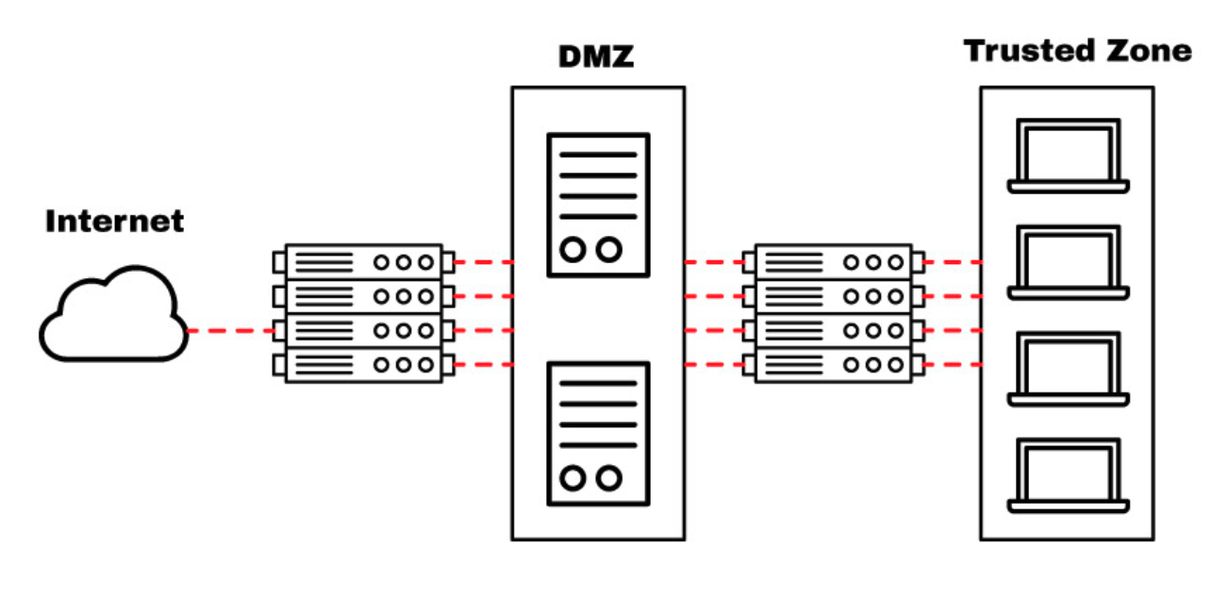
Where Can You Place An ACL?
On the edge routers.
A routing device with an ACL can be placed facing the Internet and connecting the DMZ (De-Militarized Zone).
configure an ACL in this router to protect against specific well-known ports (TCP or UDP).

Slide 7
What Are The Components of An ACL?
Sequence Number:
Identify an ACL entry using a number.
ACL Name:
Define an ACL entry using a name. Instead of using a sequence of numbers, some routers allow a combination of letters and numbers.
Remark:
Some Routers allows to add comments into an ACL, which can help to add detailed descriptions.
Statement:
Deny or permit a specific source based on address and wildcard mask. Some routing devices, such as Cisco, configure an implicit deny statement at the end of each ACL by default.

Slide 8
What Are The Components of An ACL?
Network Protocol:
Specify whether deny/permit IP, IPX, ICMP, TCP, UDP, NetBIOS, and more.
Source or Destination:
Define the Source or Destination target as a Single IP, a Address Range (CIDR), or all Addresses.
Log:
Some devices are capable of keeping logs when ACL matches are found.
Other Criteria:
Advanced ACLs allow you to use control traffic through the Type of Service (ToS), IP precedence, and differentiated services codepoint (DSCP) priority.

Slide 9
Types of Access Lists
Standard access lists
Extended access lists
Dynamic access lists
Reflexive access lists

Slide 10
Standard Access Lists
Standard IP access lists filter network traffic by examining the source IP address in a packet.
Standard access lists basically permits or denies an entire suite of protocols.
They don’t distinguish between any of the many types of IP traffic such as WWW, Telnet, UDP, etc.
It is the most basic type and can be used for simple deployments, but it does not provide strong security.

Slide 11
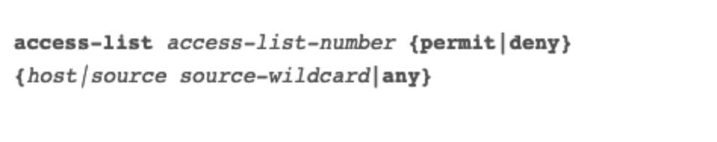
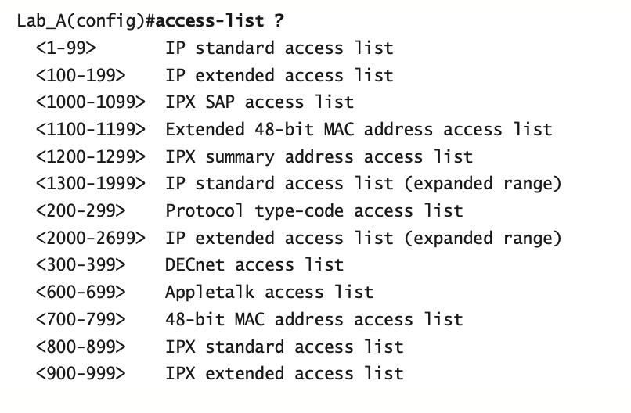
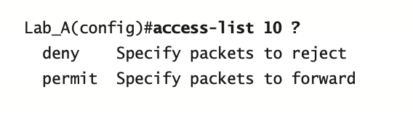
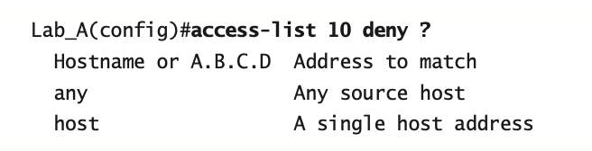
Standard Access Lists

Slide 12
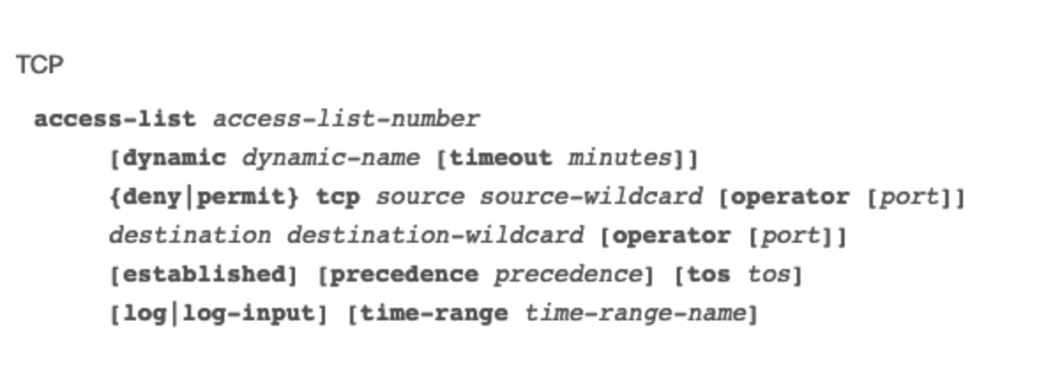
Extended Access Lists
Can be used to block source and destination for single hosts or entire networks.
Can also used an extended ACL to filter traffic based on protocol information (IP, ICMP, TCP, UDP).

Slide 13
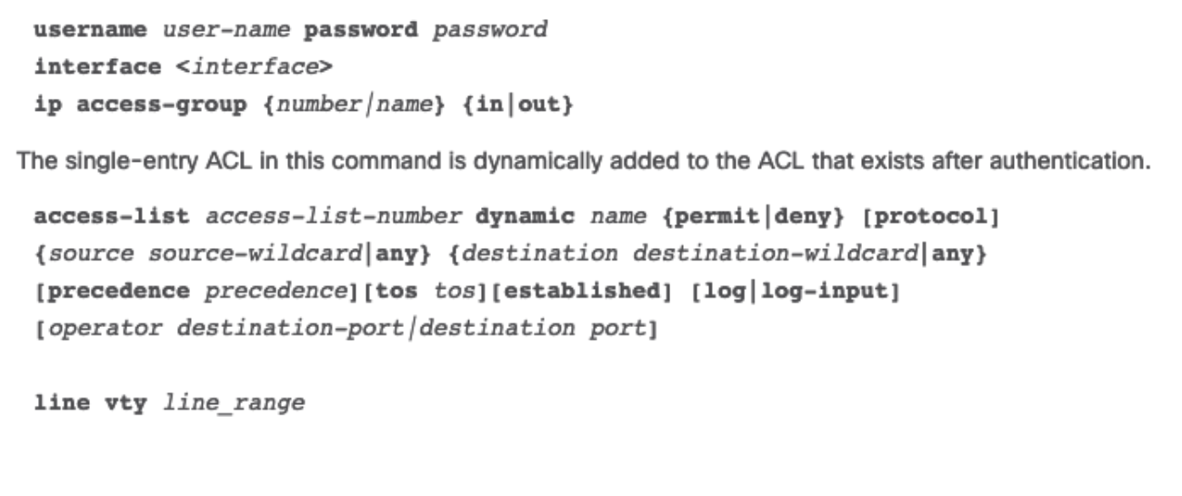
Dynamic Access Lists
Dynamic ACLs, rely upon extended ACLs, Telnet, and authentication. This type of ACLs are often referred to as “Lock and Key” and can be used for specific timeframes.
These lists permit access to a user to a source or destination only if the user authenticates to the device via Telnet.

Slide 14
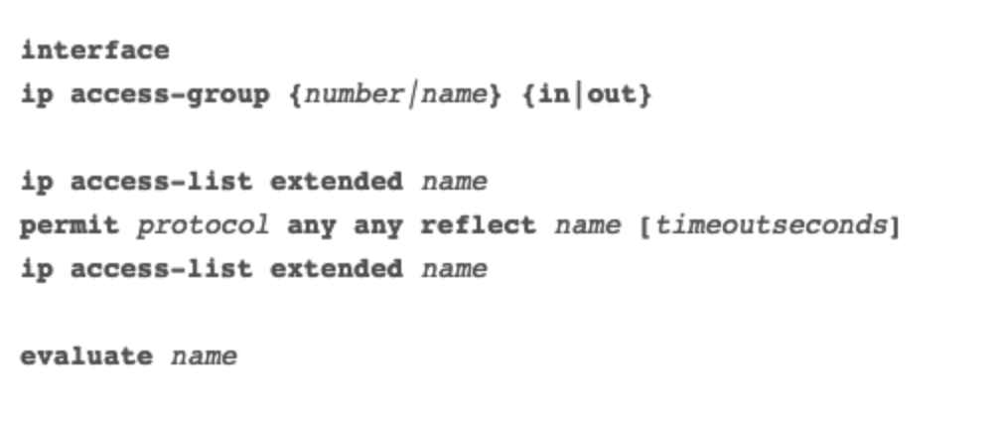
Reflexive Access Lists
Reflexive ACLs are also referred to as IP session ACLs. These type of ACLs, filter traffic based on upper layer session information.
They react to sessions originated inside the router to whether permit outbound traffic or restrict incoming traffic. The router recognizes the outbound ACL traffic and creates a new ACL entry for the inbound.
When the session finishes, the entry is removed.

Slide 15
Wildcard Masking
A wildcard mask is a string of binary digits telling the router to check specific parts of the subnet number.
Wildcard masks are referred to as inverse mask.
Wilcard mask bit 0:
  The corresponding bit value in the IP address to be tested must match the bit value in the address specified in ACL.
Wlidcard mask bit 1:
  Ignore the corresponding bit value
Just like a subnet mask, a wildcard mask is 32 bits long. It is a sort of inverted subnet masks,

Slide 16
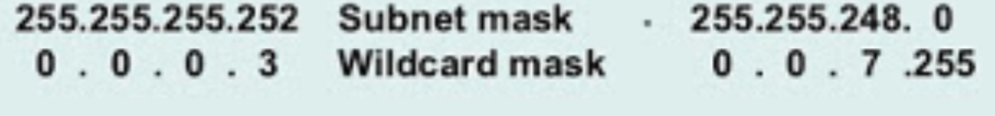
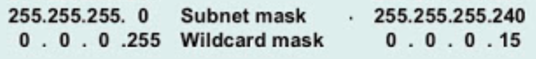
Wildcard Masking

Slide 17
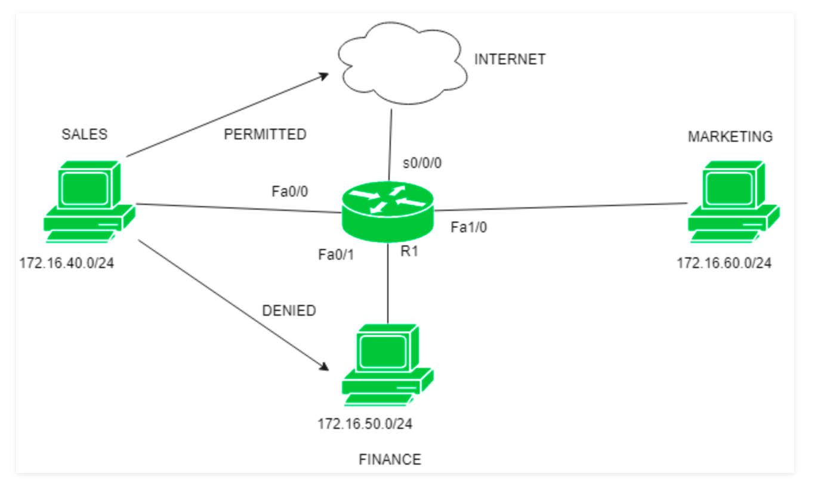
Configuration

Slide 18
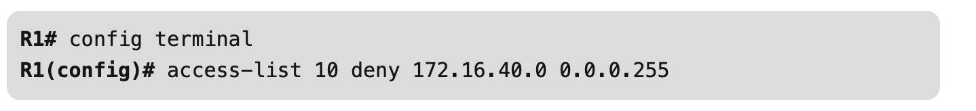
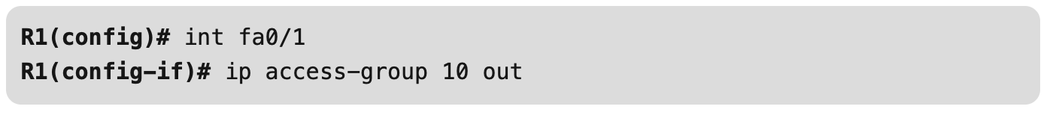

Slide 19
Thank You

